Slide 1
Human-Computer Interaction

Slide 2
HCI
Introduction

Slide 3
HCI
What is it?
Can you describe it?

Slide 4
Study of the Interaction: user/human and computers.
Human-computer interaction is a discipline concerned with the design, evaluation and implementation of interactive computing systems for human use and with the study of major phenomena surrounding them”
This interaction either Direct or Indirect.
Direct interaction involves a dialog with feedback and control throughout performance of the task.

Slide 5
Continued…
Indirect interaction may involve batch processing or intelligent sensors controlling the environment.
The important thing is that the user is interacting with the computer in order to accomplish tasks.

Slide 6
Task might be:- write document, calculate budget, solve equation, playing, learning, communicating…

Slide 7
Why Study HCI?
Business view :
To employ people more productive and effective.
    People costs now far outweigh hardware and software costs
People now expect “easy to use” systems
    generally they are not tolerant of poorly designed systems
    if a product is hard to use, they will seek other products

Slide 8
Cont..
Human Factors view :
  Humans have limitations.
  Errors are costly in terms of
  - loss of time & money
  - loss of lives in critical systems
  - loss of morale
  Due to these reasons humans need usable products.

Slide 9
The social view:
Computers contribute to critical parts of our society, and cannot be ignored
  educate our children
  take medical histories and provide expert advice
  assist humans with their everyday tasks (office automation)
  control complex machines (aircraft, space shuttles, super tankers)
  help control consumer equipment (cars, washing machines)
  entertainment (games, intellectual stimulation).…

Slide 10

Usability of Products
Think for a minute the list of interactive products

Slide 11
Interactive products include:
Cell phone, computer, personal organizer, re­mote control, soft drink machine, coffee machine, ATM, ticket machine... the list is endless.

Slide 12
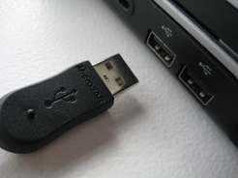
Bad design example
Plugging in a USB connector

Slide 13
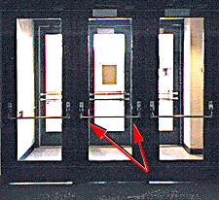
Which way to open?

Slide 14

Please push slowly!

Slide 15

Are these all usable products?

Slide 16
What is Usability?
Usability can simply be thought of as the practical implementation of good HCI, but, more formally :
Usability means easy to learn, effective to use and providing an enjoyable experience
Goals of interaction design
Develop usable products
Involve users in the design process

Slide 17
Who is involved?
The designer of an interactive system would have expertise in a range of topics:
psychology and cognitive science: to give knowledge of the user’s perceptual, cognitive and problem-solving skills;

Slide 18
Con’t
Ergonomics for the user’s physical capabilities.
Sociology to help understand the wider context of the interaction
Computer science and engineering to be able to build the necessary technology

Slide 19
Con’t
Business to be able to market it.
Graphic design to produce an effective interface presentation.
Technical writing to produce the manuals.

Slide 20
Goals of HCI
A basic goal of HCI is to improve the interactions between users and computers by making computers more usable and receptive to the user's needs. Specifically, HCI is concerned with allowing users to carry out tasks
Safely
Effectively
Efficiently
Enjoyably

Slide 21
End

